Slide 1
Things you didn't know about Jackson

Slide 2





Simon Forsberg
https://www.github.com/Zomis
@SimonForsberg
simon.forsberg @ sigma.se
Sigma IT

Slide 3
Things you didn't know about Jackson

Slide 4
Not only JSON
XML
YAML
CSV
Protobuf
Java properties files
Avro
Ion
CBOR (Concise Binary Object Representation)
Smile

Slide 5
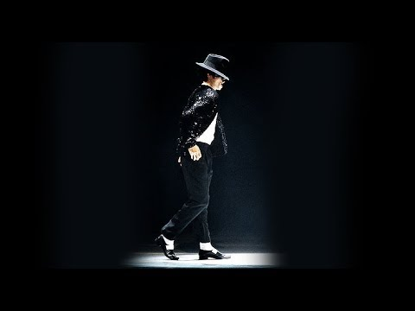
Michael Jackson's famous
"Moonwalk" is modeled after the mime artist
Marcel Marceau's routine

Slide 6
Code examples!

Slide 7
Jackson 3
Requires Java 8
Java 8 features included
ObjectMapper immutable! Use builder pattern!

Slide 8
Next steps
Use the features
Prepare for Jackson 3 by chaining configuration-calls to ObjectMapper
Tell others

Slide 9
Thank you!
Check meetup comments later for slides and code

